Slide 1
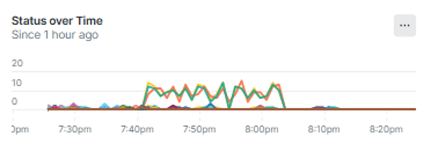
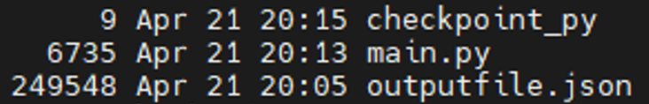

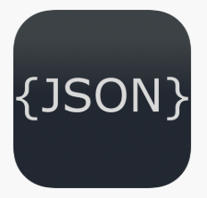



Oracle Database Transaction Output and Transform Job (dbTxOutput)
Python script runs on schedule to pull records since previous run
Records are parsed to find the latest checkpoint ID
Trenton McNeil
IS 3020
Python Project
Oracle Integration Cloud transaction logging to Oracle DB
Records output to JSON format including NewRelic compatible timestamp
Records are sent to NewRelic for reporting, process repeats at step 1

